Slide 1

IO & Arrays

Slide 2
Agenda
In this session, you will learn about:
Sending Input to Program
Displaying Output
Displaying Output as Error
Arrays
One Dimensional Arrays
Two Dimensional Arrays

Slide 3
Java IO
System.in: Handle inputs for the program, Usually getting it from user on command line.
System.out: To print to console.
System.error: To print and denote errors within application
Also there is args [] array in main, where we can pass parameters to program

Slide 4
Java IO – System.in
System.in is an InputStream which is typically connected to keyboard input of console programs.
Scanner is a class in java.util package used for obtaining the input of the primitive types like int, double etc. and strings. It is the easiest way to read input in a Java program
To create an object of Scanner class, we usually pass the predefined object System.in, which represents the standard input stream
Scanner scanner = new Scanner(System.in);

Slide 5
Java IO – System.in
Get Inputs of Multiple data types
Scanner scanner = new Scanner(System.in);
System.out.println("Enter a String");
String input = scanner.nextLine();
System.out.println("Enter Number");
//Attempting to provide input other than number will throw exception
int number = scanner.nextInt();
Notes:
semester2\1-java8\2-arrays-strings-collections-generics\2-class-exercises-and-demos\arrays-strings-collections-generics\src\com\imarticus\tutorial\arraystringcollectiongenerics\demos\ioarrays\GetInput.java

Slide 6
Java IO – Sending Input as arguments
The java command-line argument is set of parameters beingpassed at the time of running java program.
The arguments passed from the console can be received in the java program and it can be used as an input
The arguments can be accessed from the main program with the variable args in the above statement
args[0] will give you the first argument
args[1] will give you the second argument
public static void main(String[] args){}

Slide 7
Java IO – Sending Input as arguments
Consider the example
public class CommandLineArgs {
public static void main(String[] args) {
System.out.println("First Argument:" + args[0]);
System.out.println("Second Argument:" + args[1]);
}
}
Notes:
semester2\1-java8\2-arrays-strings-collections-generics\2-class-exercises-and-demos\arrays-strings-collections-generics\src\com\imarticus\tutorial\arraystringcollectiongenerics\demos\ioarrays\CommandLineArgs.java

Slide 8
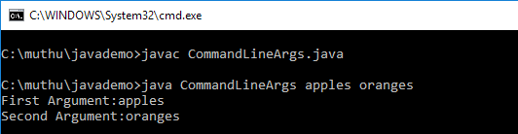
Java IO – Sending Input as arguments
Now compile and run in command prompt by
While executing the java program, we have passed two arguments
apples
Oranges
The two arguments are provided immediately after the java {class name} delimeted with space

Slide 9
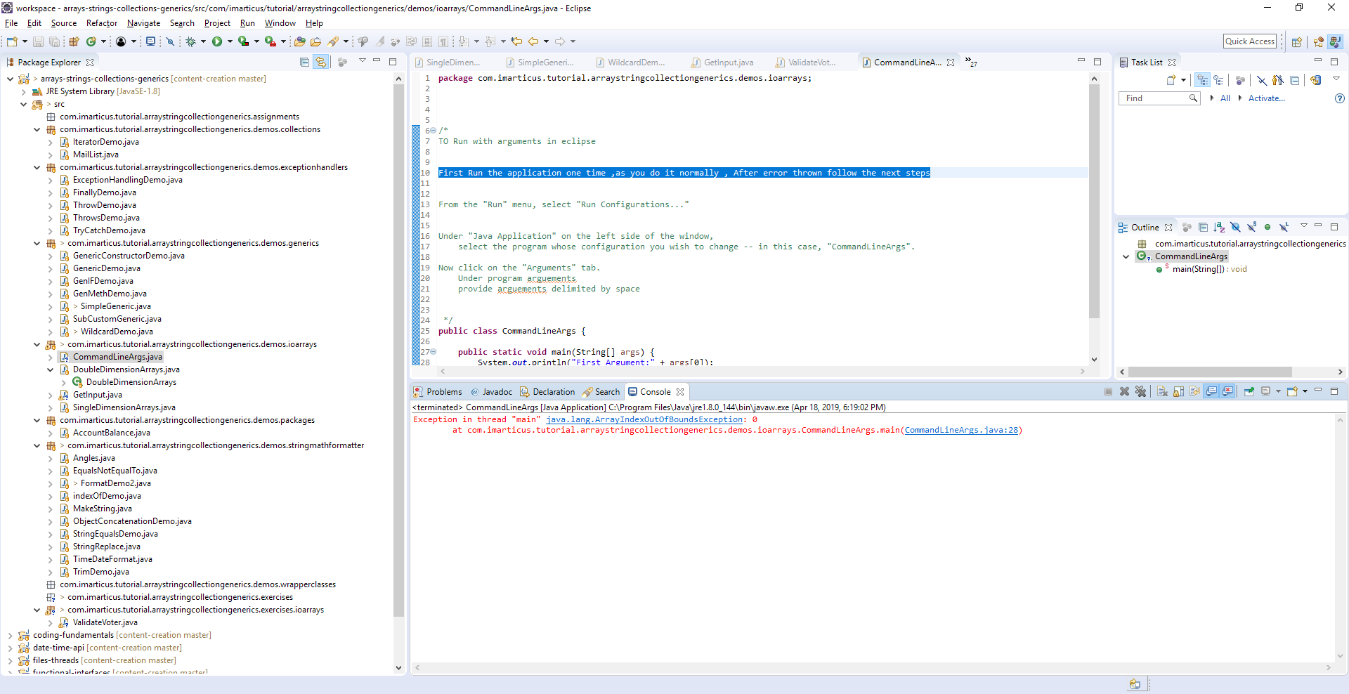
Java IO – Sending Input as arguments
To pass command line arguments in eclipse
First Run the application one time, as you do it normally, error will be thrown at output
We are good now proceed to next steps

Slide 10
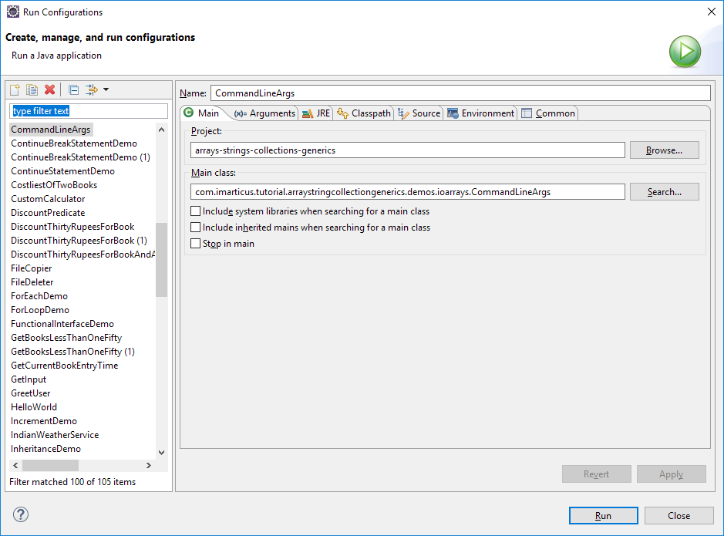
Java IO – Sending Input as arguments
To pass command line arguments in eclipse
From the "Run" menu, select "Run Configurations...“
Ensure Our class name is shown under the name

Slide 11
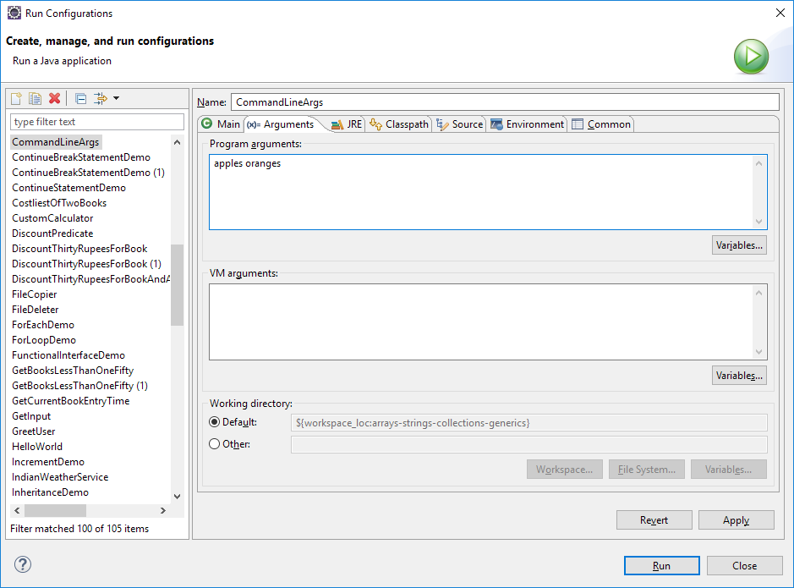
Java IO – Sending Input as arguments
To pass command line arguments in eclipse
Click on Arguments tab
Under program arguments
provide arguments delimited by space

Slide 12
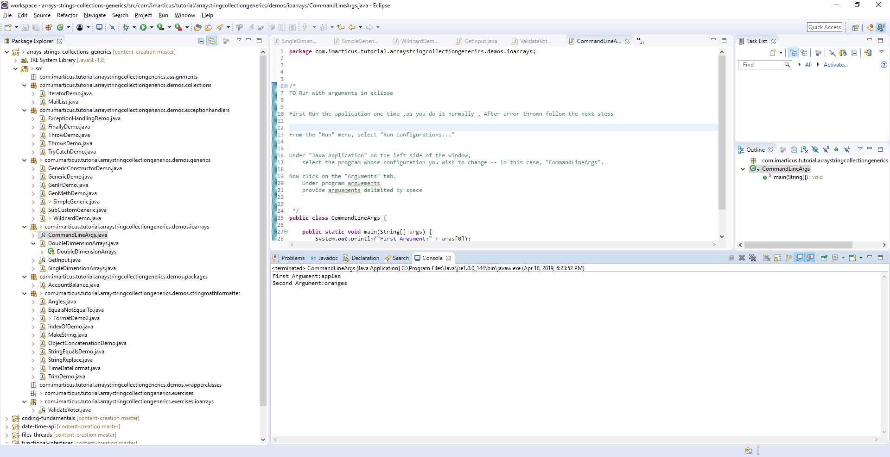
Java IO – Sending Input as arguments
To pass command line arguments in eclipse
Now click apply and press the run button
You should see something like this below in console window

Slide 13
Java IO – System.err
System.err is a PrintStream.
System.err works like System.out except it is normally only used to output error texts.
Eclipse will show the output to System.err in red text, to make it more obvious that it is error text.
System.err.println(“Invalid input");

Slide 14

Exercise
Get Input for name & age
If age greater than or equal to 18, print message using System.out
“Welcome {name}, You are eligible to vote”
If age less than 18, print error message mentioning
Sorry {name}, You are not eligible to vote

Slide 15
Arrays
Arrays in Java
An array is a group of like-typed variables that are referred to by a common name.
Arrays of any type can be created and may have one or more dimensions.
A specific element in an array is accessed by its index.
Arrays offer a convenient means of grouping related information.

Slide 16
Arrays in Java
One dimensional Array
A one-dimensional array is, essentially, a list of like-typed variables.
The general form of a one-dimensional array declaration is type:
var-type var-name[ ];
Here, type declares the base type of the array. The base type determines the data type of each element that comprises the array.

Slide 17
Arrays in Java
One dimensional Array – Declaration
Declaring an array named months with the type “array of int”:
months is an array variable,which represents an array with no value.
Allocation of array variable to the array,
Here, type specifies the type of data being allocated,
size specifies the number of elements in the array,
array-var is the array variable that is linked to the array.
Allocating a 12-element array of integers and links them to months.
int months[];
array-var = new type[size];
months = new int[12];

Slide 18
One dimensional Arrays
Accessing array Elements
Elements in the array can be accessed by specifying its index within square brackets.
All array indexes start at zero.
For example,
Assigning the value 28 to the second element of months.
Displaying the value stored at index 3.
months[1] = 28;
System.out.println("April has " + months[3] + " days.");

Slide 19
One dimensional Arrays
One dimensional Array - Demonstration
int months[];
months = new int[12];
months[0] = 31;
months[1] = 28;
months[2] = 31;
months[3] = 30;
months[4] = 31;
months[5] = 30;
months[6] = 31;
months[7] = 31;
months[8] = 30;
months[9] = 31;
months[10] = 30;
months[11] = 31;
System.out.println("April has " + months[3] + " days.");
Notes:
semester2\1-java8\2-arrays-strings-collections-generics\2-class-exercises-and-demos\arrays-strings-collections-generics\src\com\imarticus\tutorial\arraystringcollectiongenerics\demos\ioarrays\SingleDimensionArrays.java

Slide 20
Exercise
Create a class BookSearchEngine with a variable books of type String array with following values
The Power of your Subconscious Mind
Great Gatsby
The Alchemist
Fundamentals of Wavelets
Data Smart
God Created the Integers
Superfreakonomics
Orientalism
Nature of Statistical Learning Theory, The
Integration of the Indian States
Drunkards Walk, The
Image Processing & Mathematical Morphology
How to Think Like Sherlock Holmes
Data Scientists at Work
Slaughterhouse Five

Slide 21
Exercise
Create a method searchForBookAndPrint
which accepts one String as parameter.
Print the book names matched with search
Use StringA.contains(StringB) method
Will return true if StringA has the content StringB

Slide 22
Arrays in Java
Multi dimensional arrays
Multidimensional arrays are arrays of arrays.
Can be declared by specifing each additional index using another set of square brackets. For example, the following declares a twodimensional array variable called matrix.
This allocates a 4 by 5 array and assigns it to matrix.
Internally this matrix is implemented as an array of arrays of int.
int matrix[][] = new int[4][5];

Slide 23
Multi dimensional arrays
Multi dimensional arrays – Matrix Addition
int matrixOne[][] = { { 1, 3, 4 }, { 2, 4, 3 }, { 3, 4, 5 } };
int matrixTwo[][] = { { 1, 3, 4 }, { 2, 4, 3 }, { 1, 2, 4 } };
// creating another matrix to store the sum of two matrices
int matrixResult[][] = new int[3][3]; // 3 rows and 3 columns
// adding and printing addition of 2 matrices
for (int i = 0; i < 3; i++) {
for (int j = 0; j < 3; j++) {
matrixResult[i][j] = matrixOne[i][j] + matrixTwo[i][j];
System.out.print(matrixResult[i][j] + " ");
}
System.out.println();// new line
}

Slide 24
Arrays in Java
Alternative Array declaration Syntax
type[ ] var-name;
Here, the square brackets follow the type specifier, and not the name of the array variable. For example, the following two declarations are equivalent
The following declarations are also equivalent:
int al[] = new int[3];
int[] a2 = new int[3];
char matrix1[][] = new char[3][4];
char[][] matrix2 = new char[3][4];

Slide 25
Arrays in Java
Alternative Array declaration Syntax
This alternative declaration form offers convenience when declaring several arrays at the same time.
For example,
It is the same as writing:
int[] nums, nums2, nums3;
// create three arrays creates three array variables of type int.
int nums[], nums2[], nums3[];

Slide 26





AWARDS:
Learn more:
https://imarticus.org/corporate/
Email us:
info@imarticus.com
Connect with us:
www.linkedin.com/company/imarticuslearning
ACCREDITED TRAINING PARTNER:
Watch us:
www.youtube.com/ImarticusLearninginstitute
Visit us:
Mumbai | Thane | Pune | Bangalore | Delhi - NCR | Hyderabad | Chennai | Coimbatore

